Slide 1
Gene Construct at Chr8: 742500
By: Tanveer Salim

Slide 2
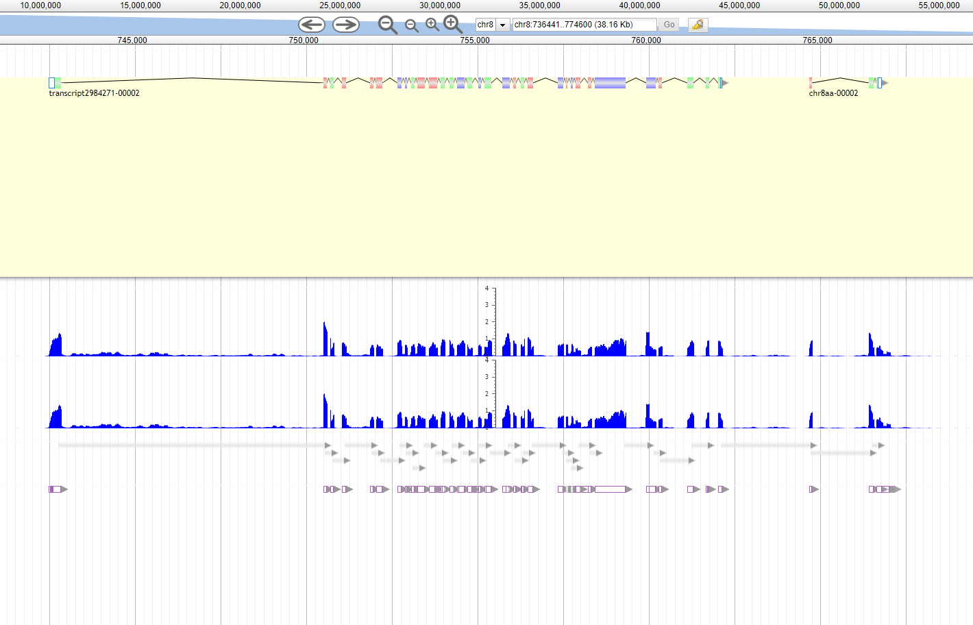
Picture of Gene Construct

Slide 3
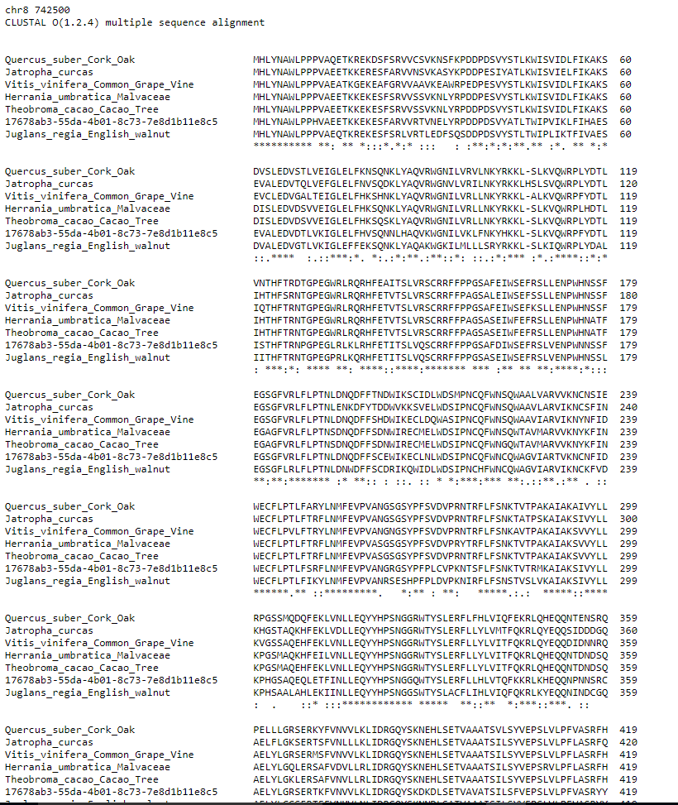
Multiple Sequence Alignment

Slide 4
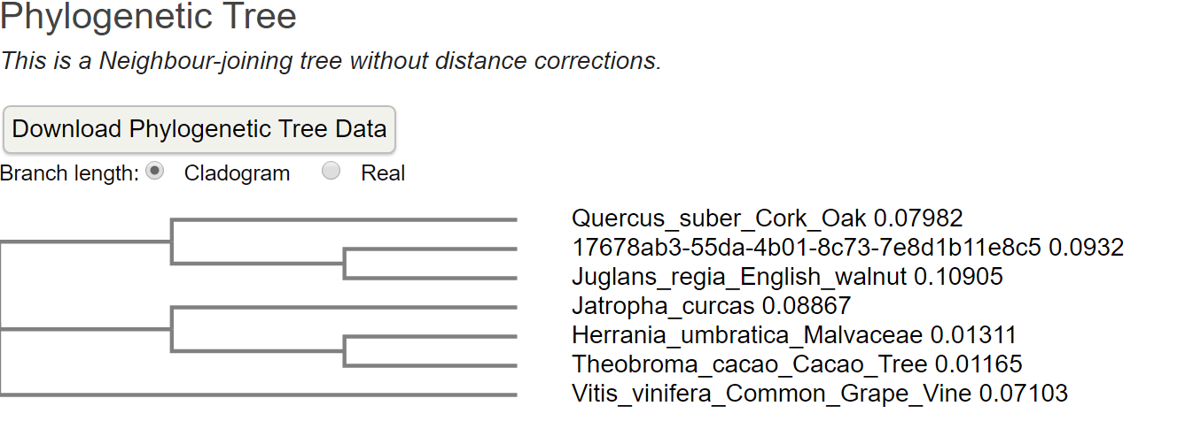
Phylogenetic Tree

Slide 5
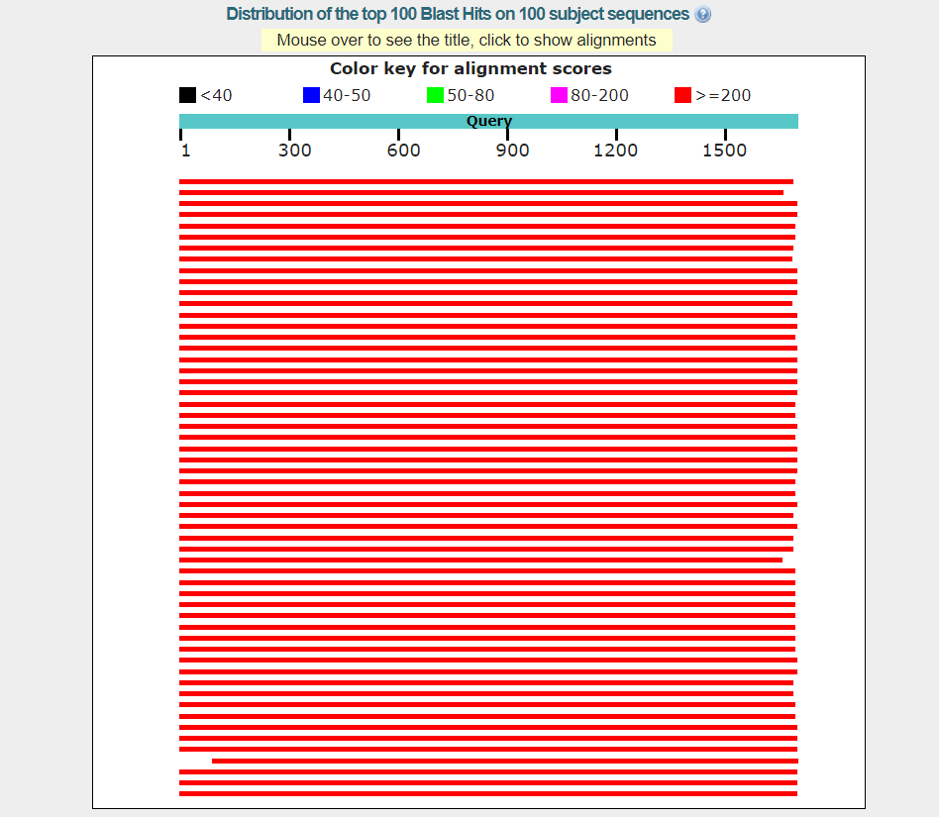
Color Key

Slide 6
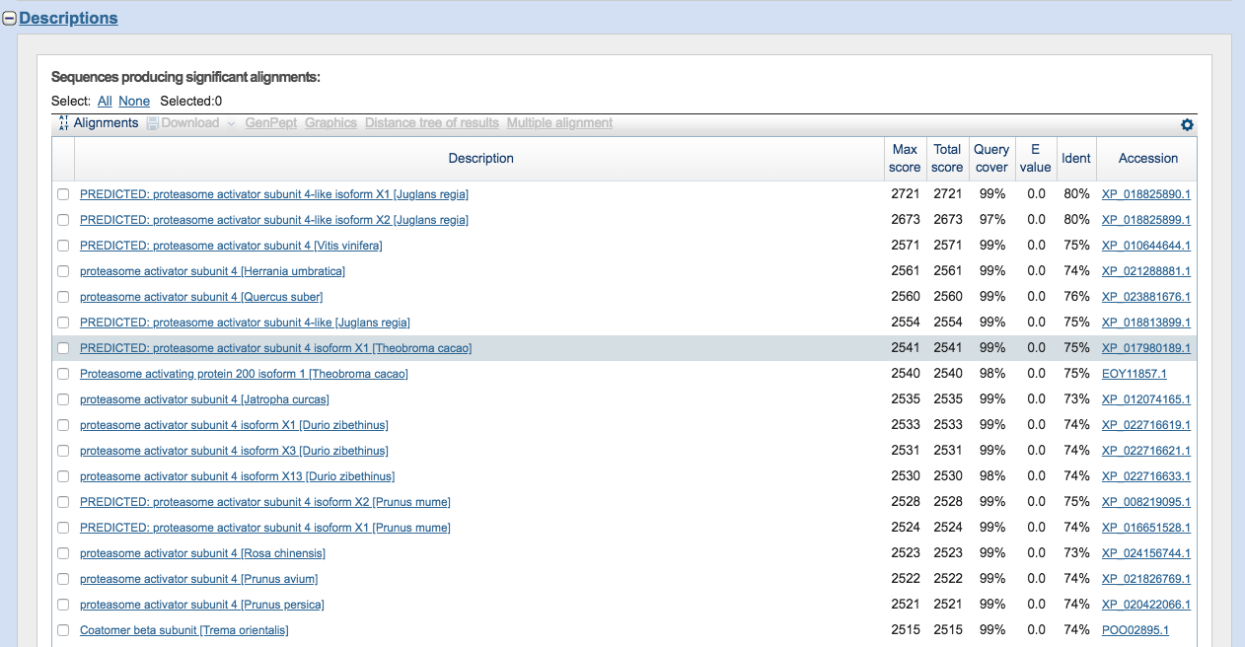
BLASTp Results

Slide 7
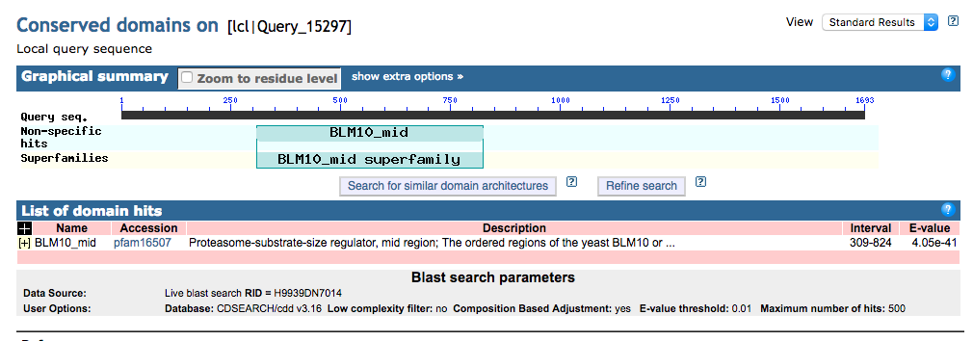
Putative Conserved Domains

Slide 8
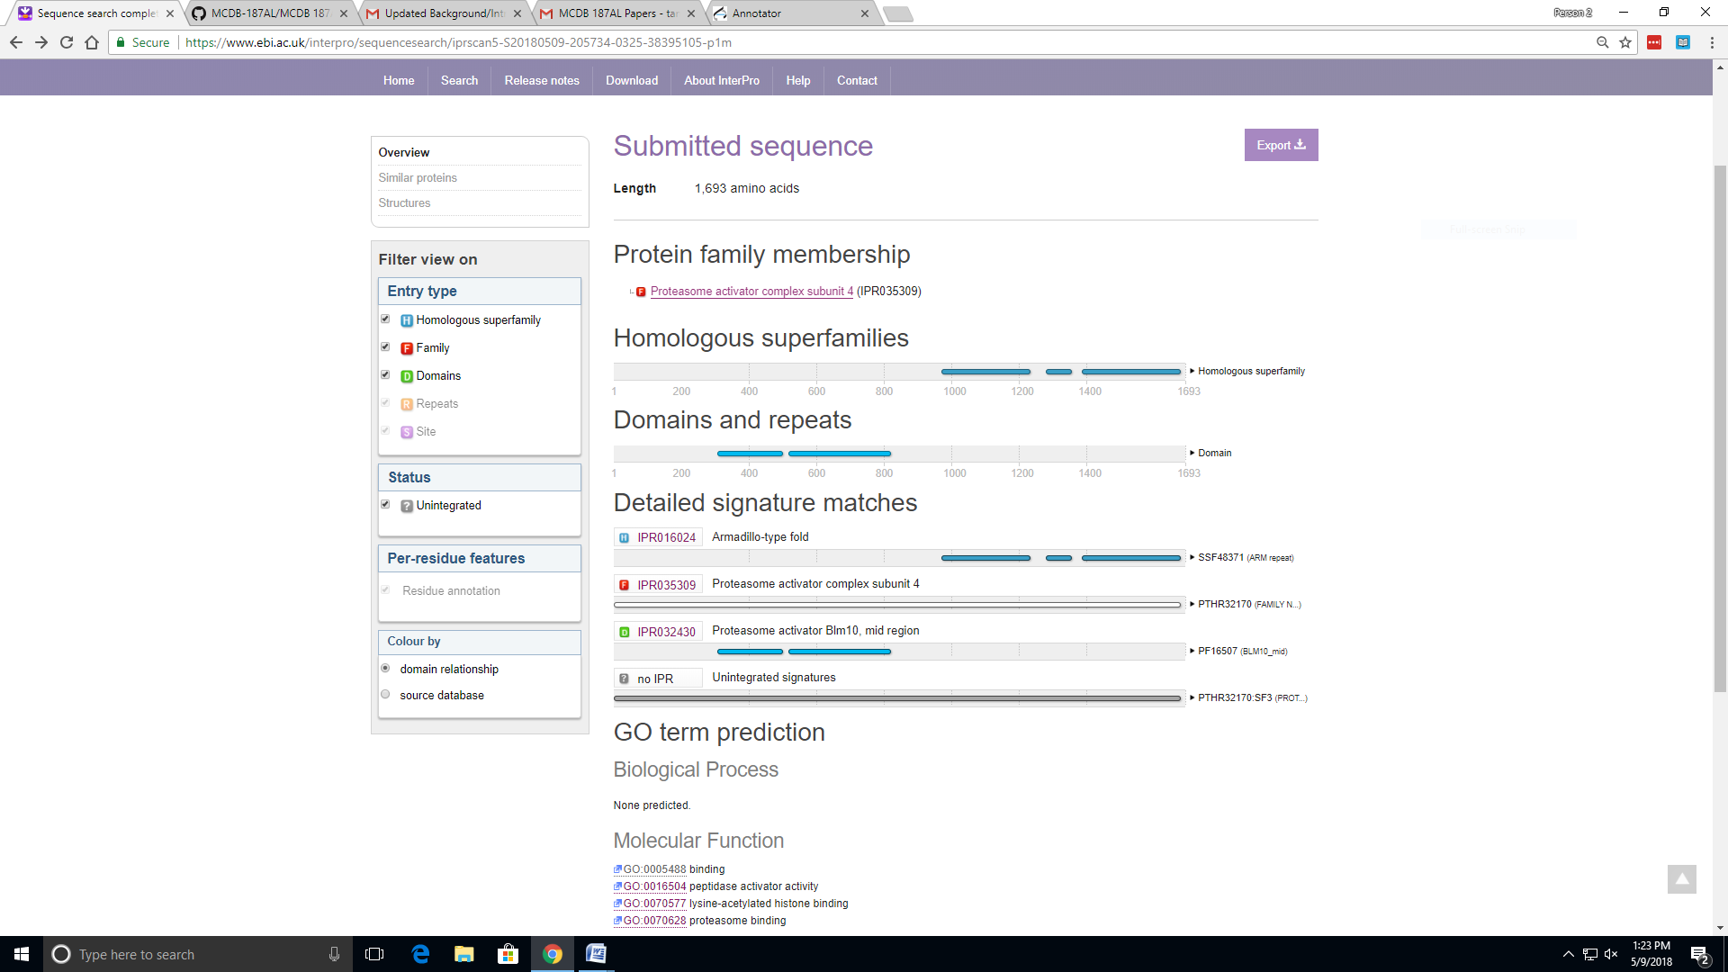
InterProScan Results

Slide 9
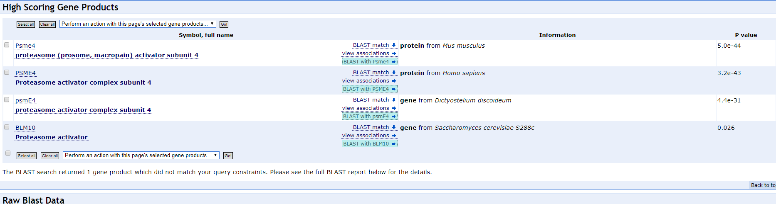
AMIGO

Slide 10
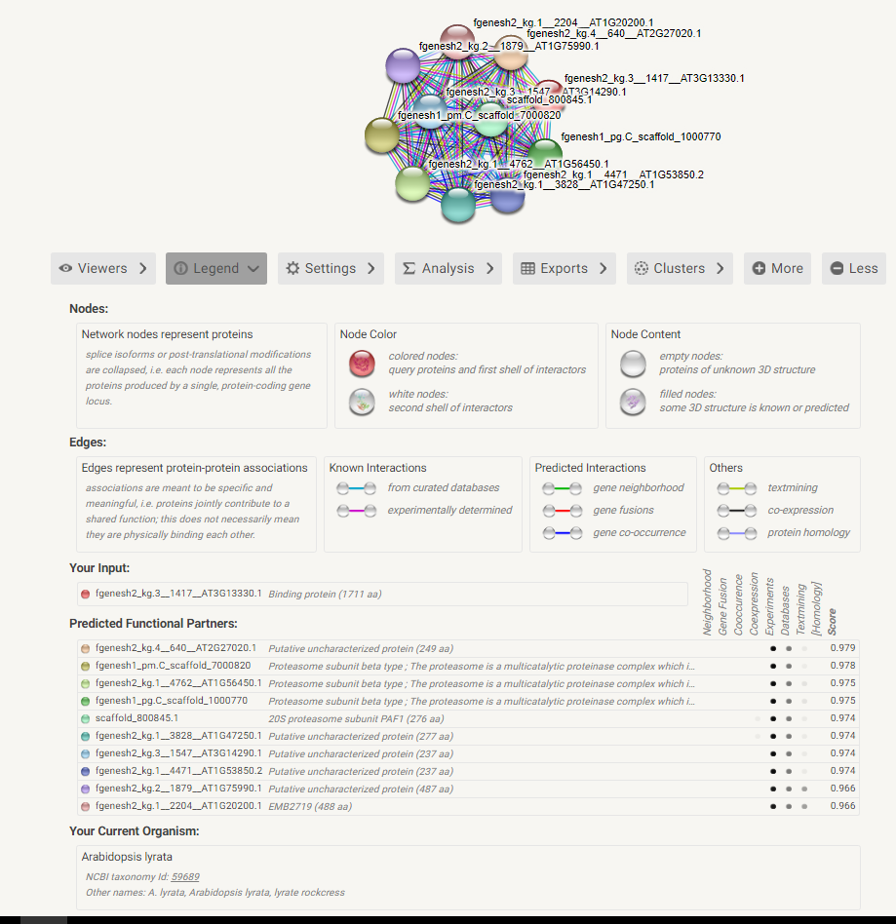
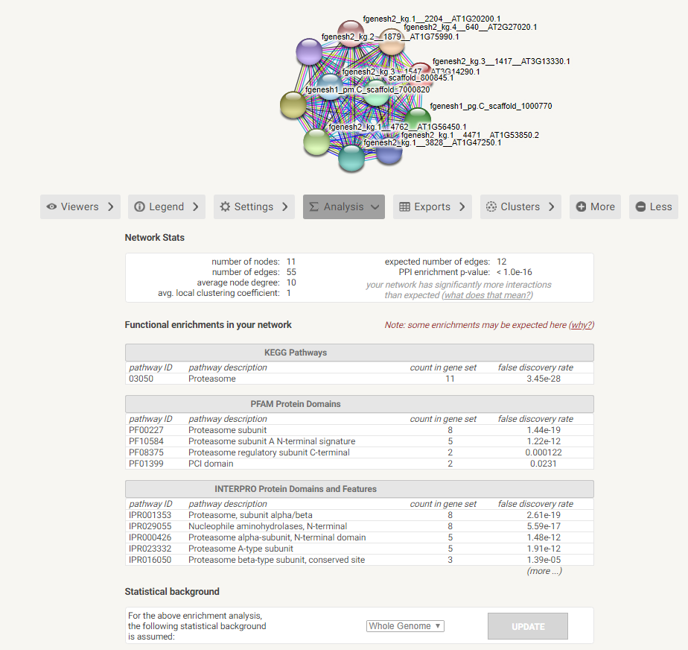
String-DB Results

Slide 11
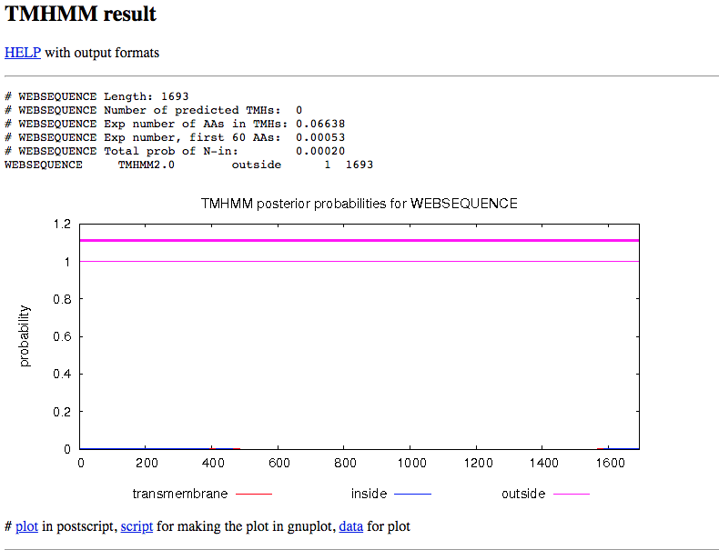
TMHMM Results

Slide 12
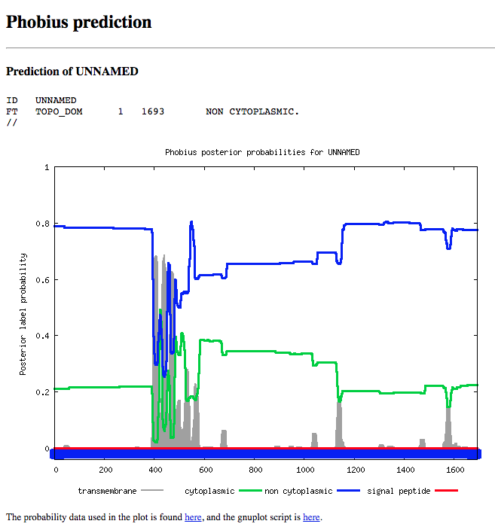
Phobius Results

Slide 13
Significance of Proteosome Activator Subunit 4
The proteasome: An approximately ~700000 Dalton, cylinder-shaped protease arranged as four axially stacked heptameric rings.
It recognizes acetylated histones and promotes ATP and ubiquitin-independent degradation of core histones during spermatogenesis and DNA damage response.
Activates proteasome by opening gate channel to allow substrates to pass through channels.
Is a component of a proteasome active in spermatogenesis (pollen generation in Quercus lobata’s case). It binds to acetylated histones and promotes degradation of histones. This assists in the exchange of histones during spermatogenesis.
Assists in DNA Repair by degrading histones after a DNA double-strand break forms.
References: "Acetylation-mediated proteasomal degradation of core histones during DNA repair and spermatogenesis.“ and

Slide 14
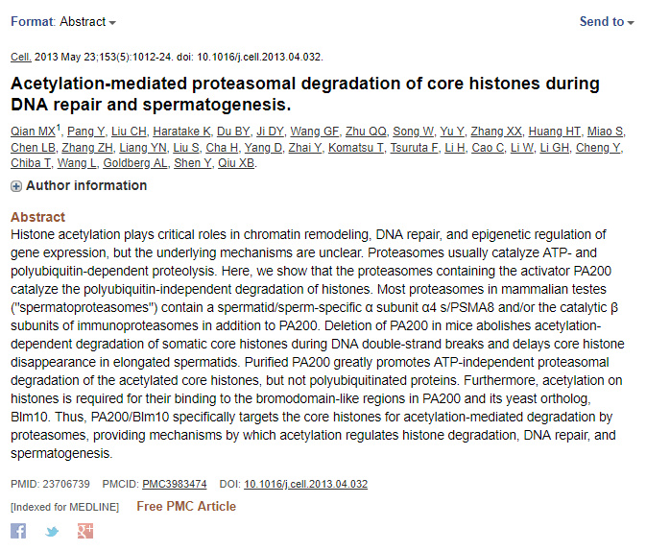
Reference: "Acetylation-mediated proteasomal degradation of core histones during DNA repair and spermatogenesis.“

Slide 15
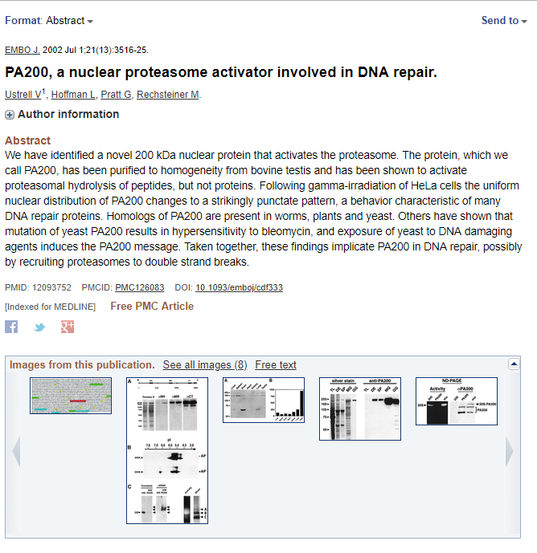
References: "PA200, a nuclear proteasome activator involved in DNA repair."

Slide 16
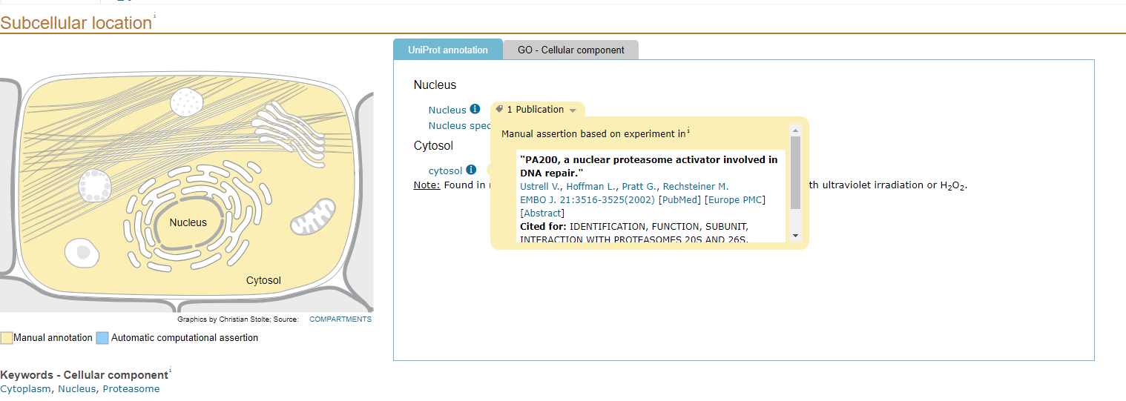
Cellular Localization
Proteosome Activator Complex Subunit 4 is found in Nucleus and cytosol

